Slide 1
Genre Requirements
Mrs. Zacharias – Middle School

Slide 2
Overview
Students will read 20 books during the school year
Books should be 100+ pages (exceptions may apply to some books)
Books 300+ pages count as two books

Slide 3
Required Genres
Poetry
Traditional Literature
Historical Fiction
Mystery
Fantasy
Science Fiction
Biography, Autobiography, and/or Memoir
Informational
Realistic Fiction

Slide 4
Poetry
Genre Requirements

Slide 5
What is Poetry?
Literary work in which special intensity is given to the expression of feelings and ideas by ideas by the use of distinctive style and rhythm

Slide 6
Poetry
Silly poets: Shel Silverstein, Jack Prelutsky, Dr. Seuss
Middle school: Sharon Creech, Bob Raczka, Kwame Alexander
I encourage you to read something other than silly poets

Slide 7
Traditional Literature
Genre Requirements

Slide 8
Traditional Literature
Stories that have been passed down through generations
Types:
Proverbs
Fairytales
Folklore
Fables
Animal tales
Myths
Legends
Biblical stories

Slide 9
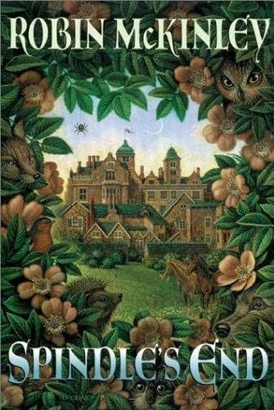
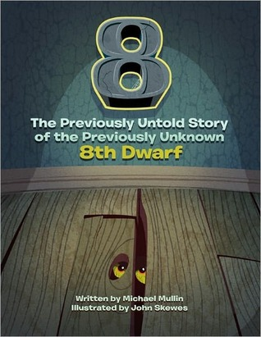
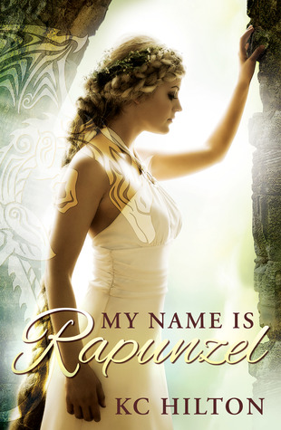
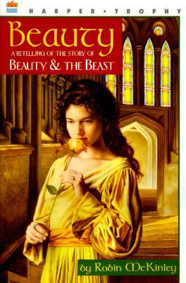
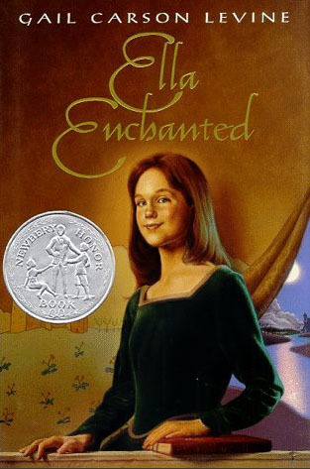
Fairy Tales

Slide 10
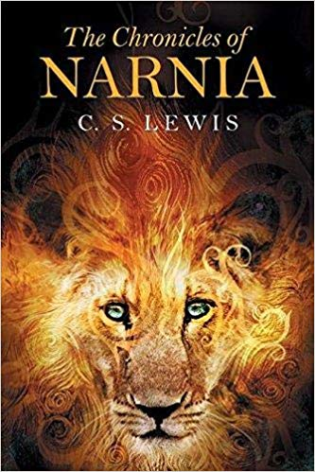
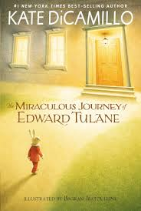
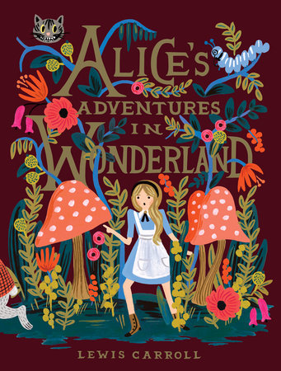
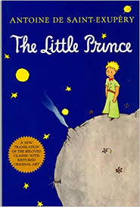
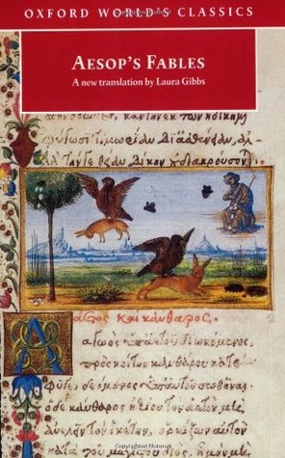
Fables

Slide 11
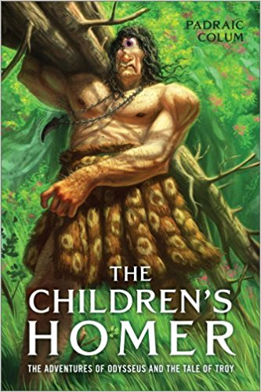
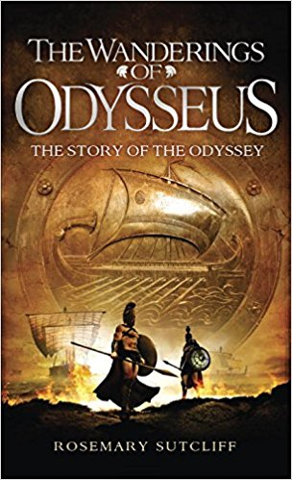
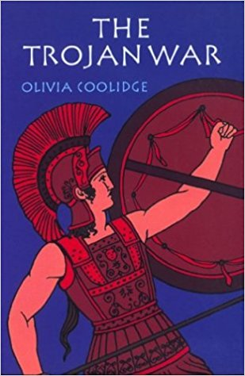
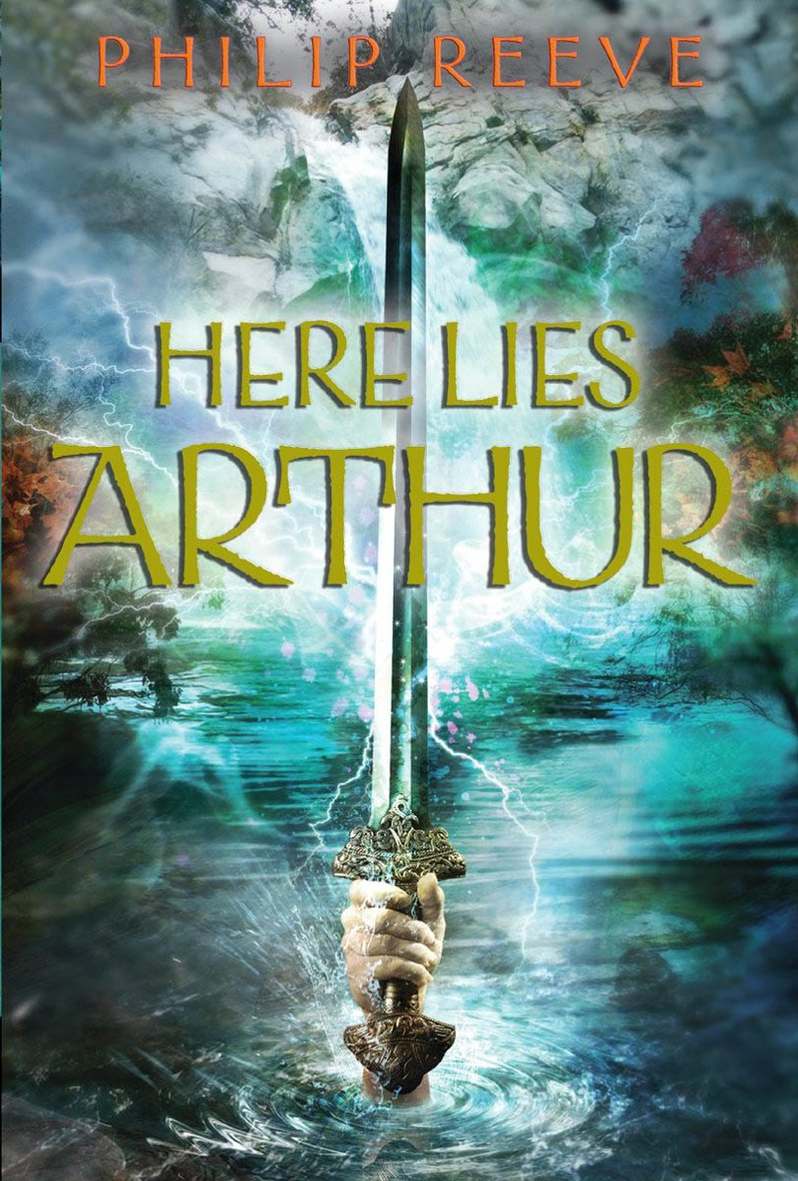
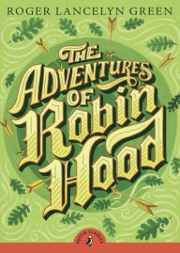
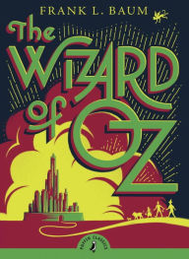
Legends

Slide 12
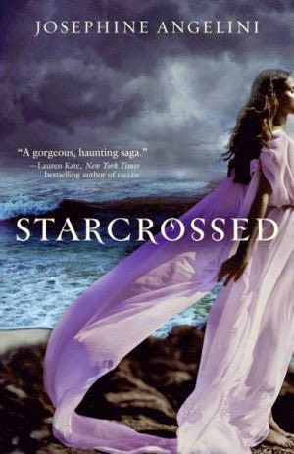
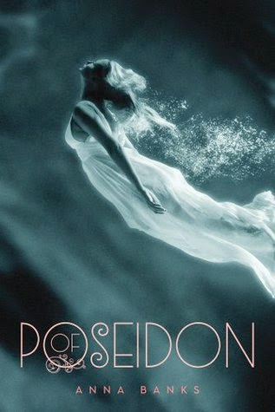
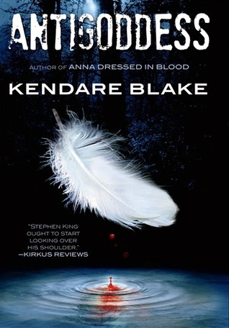
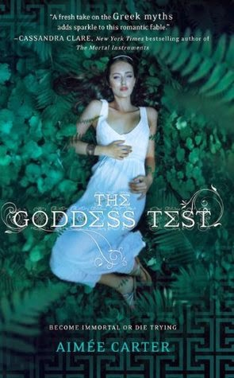
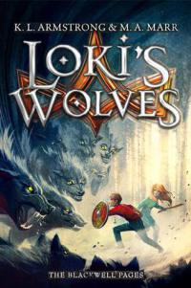
Myths

Slide 13
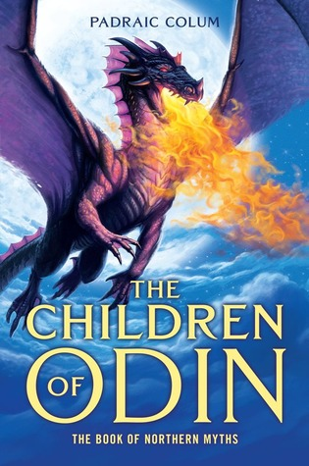
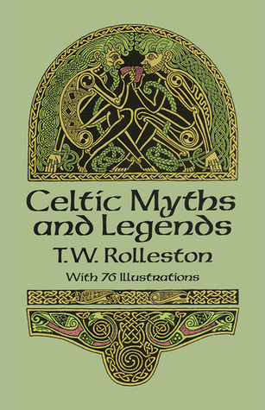
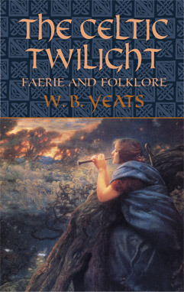
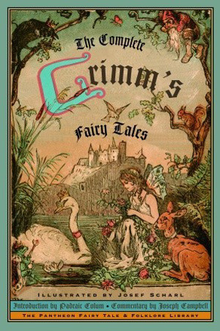
Folklore

Slide 14
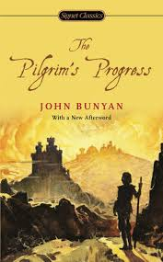
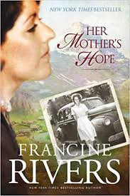
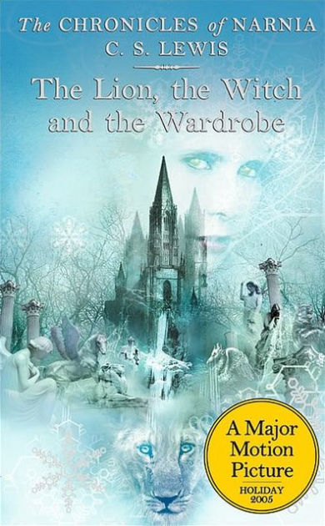
Biblical Stories

Slide 15
Historical Fiction
Genre Requirements

Slide 16
What is Historical Fiction?
Written to portray a time period or convey information about a specific time period or a historical event
Usually the time period is about 30 years in the past

Slide 17
Characteristics
Setting is the most important literary element
Setting information should be accurate and authentic
Details from the story should match the time period
Characters may be real or made up
Story should seem like it could have really happened

Slide 18
Historical Fiction
What to read?
Find a time period or historical event you’re interested in and search for a book
If you need recommendations, ask Mrs. Zacharias!

Slide 19
Mystery
Genre Requirements

Slide 20
What is Mystery?
Typically, it involves a detective or other professional seeking to solve a crime
Main idea is to solve a puzzle

Slide 21
Characteristics
Plot focuses on key events about the crime
The protagonist is usually the one trying to solve the crime
The other characters are often suspects
Lots of dramatic tension
Often includes plot twists

Slide 22
Often see
Figuring out suspects’ motives
Analyzing suspects’ alibis
Overt clues
Hidden evidence
Gaps in information
Foreshadowing
Red herrings

Slide 23
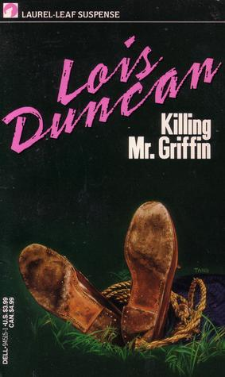
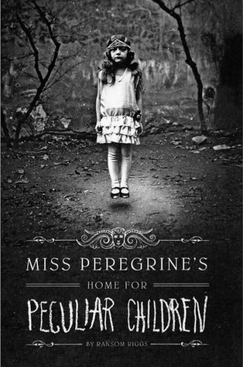
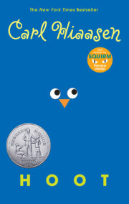
Mystery

Slide 24
Fantasy
Genre Requirements

Slide 25
What is Fantasy?
Imaginary, make-believe, and pretend
Unreal things that could never happen in our world

Slide 26
Types
Some begin and end in a fantasy world
Others start in the real world and move into fantasy world
Some are set in the real world but with elements of magic in it

Slide 27
Things You May See
Unreal creatures like: fairies, dragons, wizards, ogres
Portals between worlds
Magic or supernatural elements

Slide 28
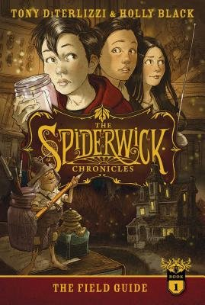
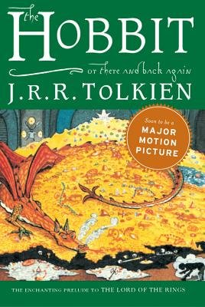
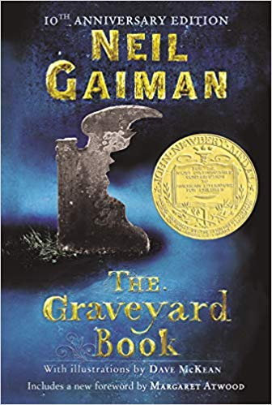
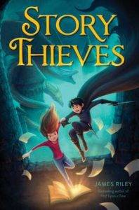
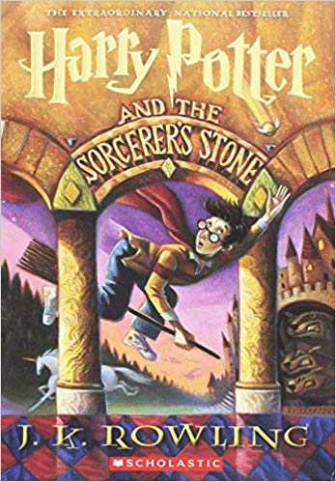
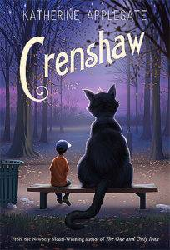
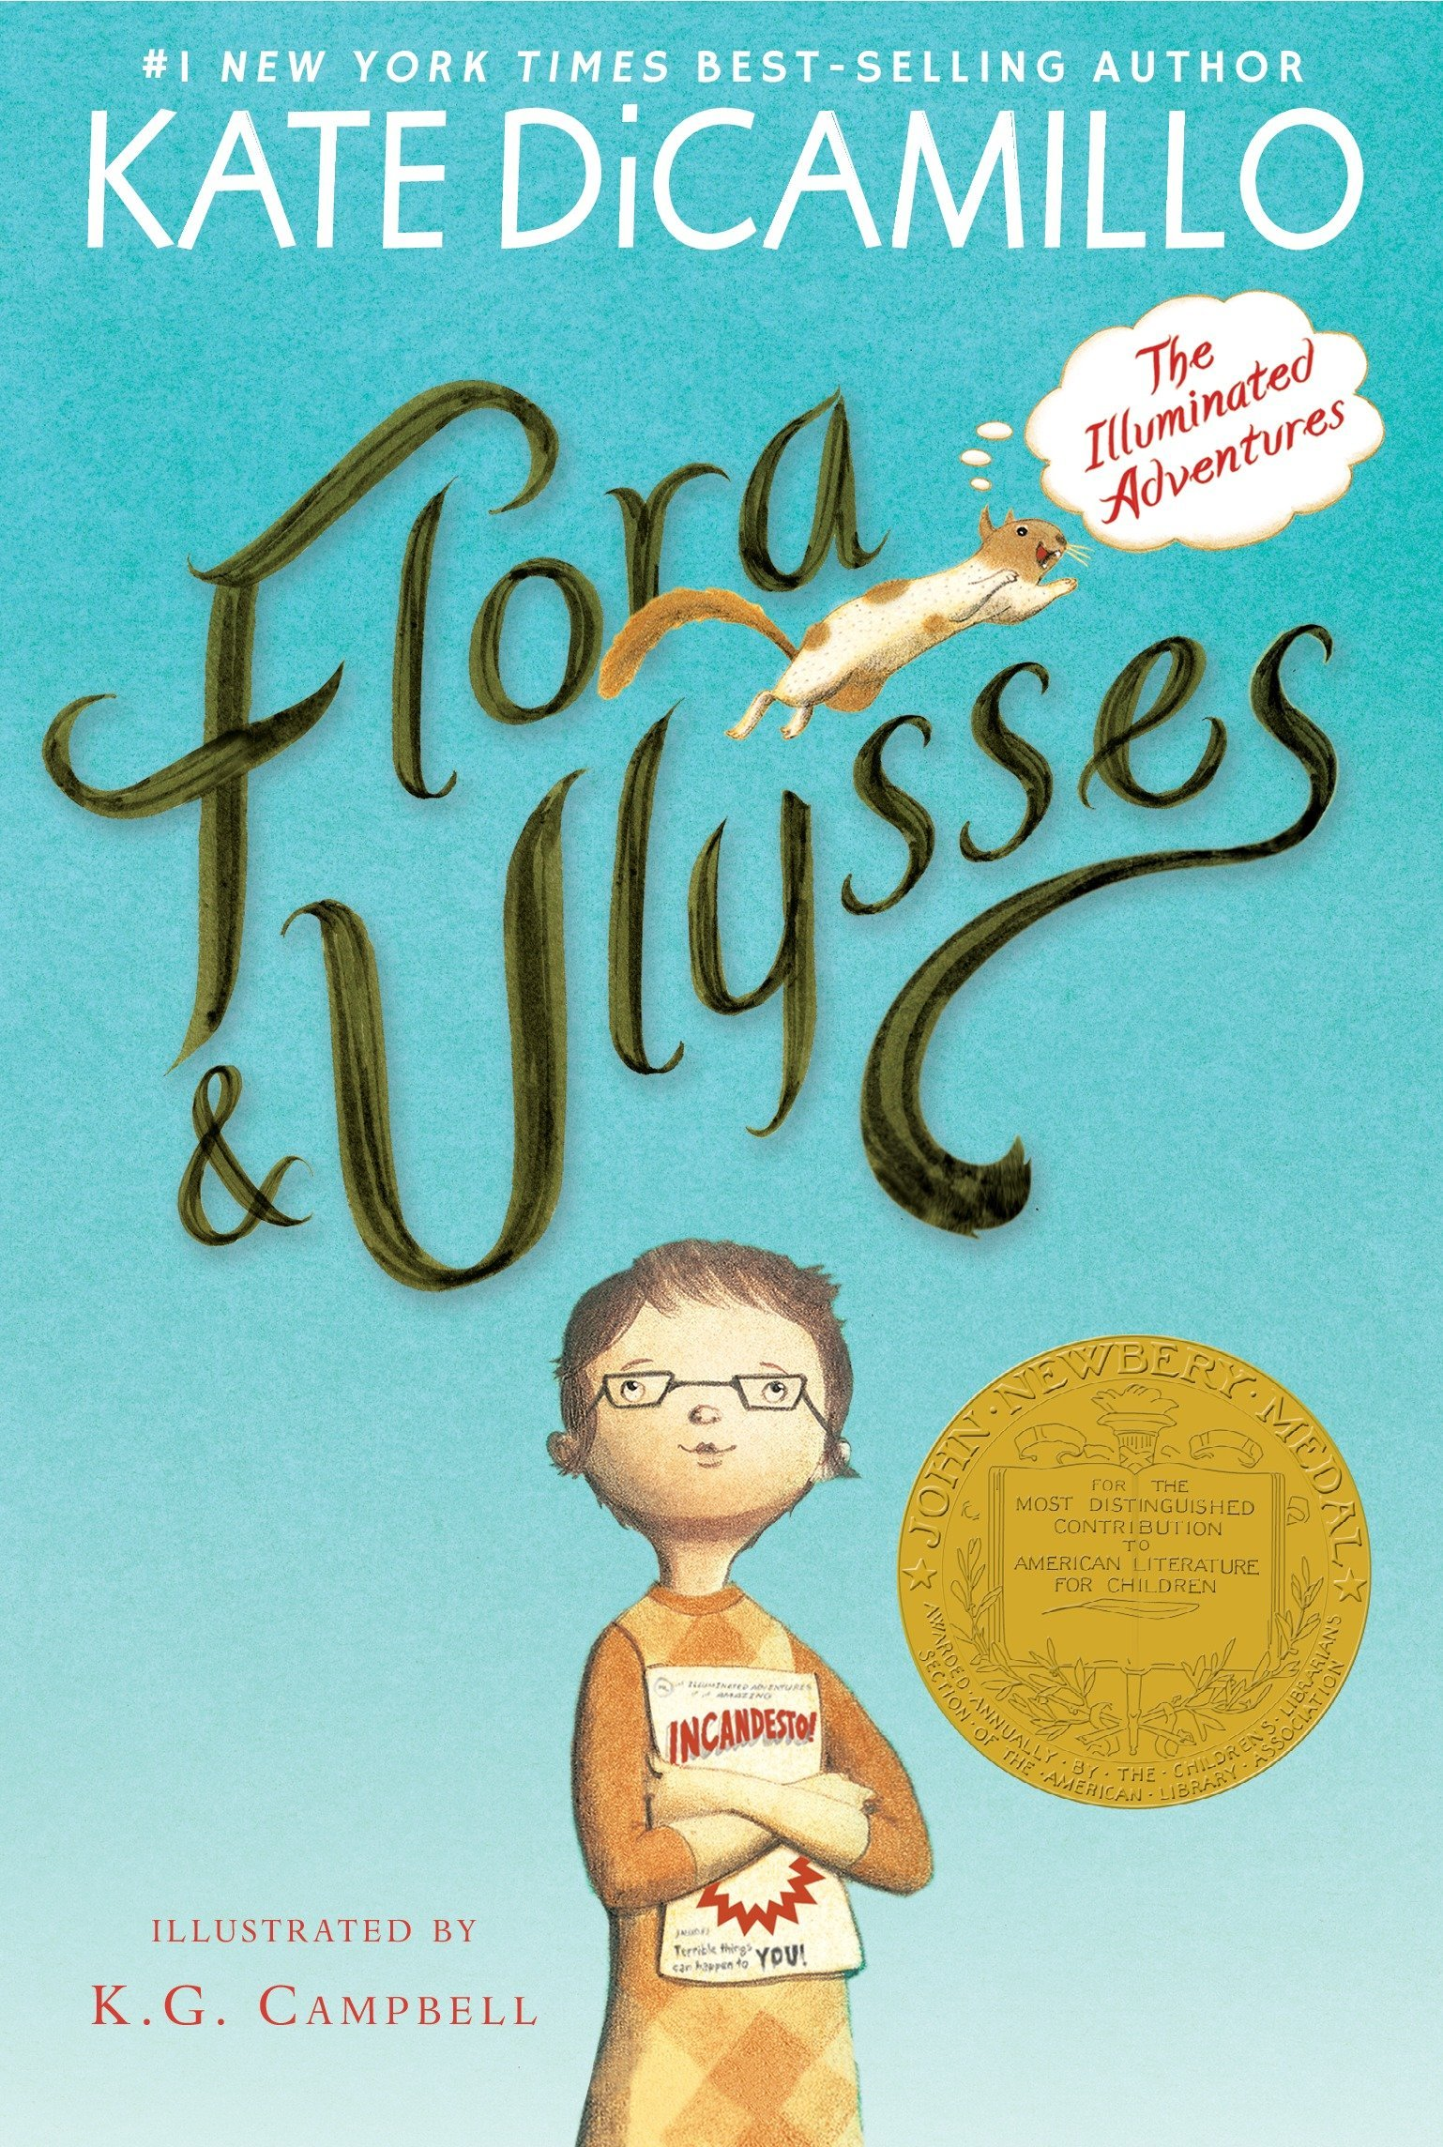
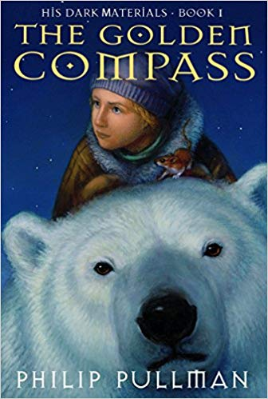
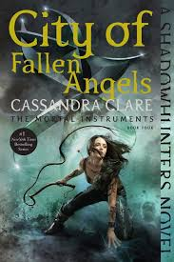
Fantasy

Slide 29
Fantasy Fiction vs. Traditional Literature
Fantasy fiction has a definite author. Traditional literature has been passed down and does not have a known original author.

Slide 30
Science Fiction
Genre Requirements

Slide 31
What is Science Fiction?
Stories tell about science and technology of the future
Often set in the future, in space, on a different world, or in a different universe or dimension
Unreal things that could be real in our world in the future

Slide 32
Characteristics
Science fiction often attempts to answer the question, “What if?”
It often explores what could go wrong with the world
The setting is often our real world

Slide 33
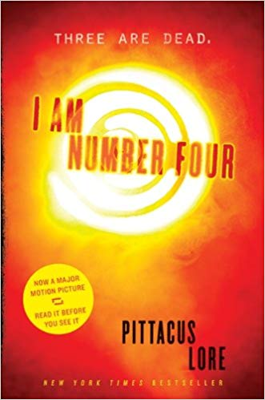
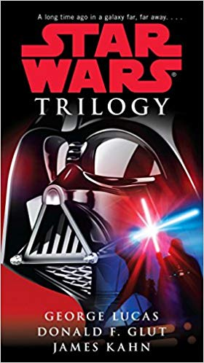
Science Fiction

Slide 34
Science Fiction vs. Fantasy Fiction
Science fiction involves more science
Fantasy is less believable (realistic)
Science Fiction is possible with technology/science

Slide 35
Biography, Autobiography, and Memoir
Genre Requirements

Slide 36
What are biographies, autobiographies, and memoirs?
Nonfiction
Tells the true account of someone’s life

Slide 37
Biography
An account of someone’s life as told by someone else
Usually covers a person’s entire life
Not only states facts, but attempts to interpret those facts to explain that person’s feelings or motivations
Uses many forms of information – speeches, interviews, letters, etc.
Uses pictures, maps, letters, and other historically available documents
Person may be alive or deceased

Slide 38
Autobiography
An account of someone’s life as told by themselves
Usually written in first person
Events are told as the narrator/author remembers them
Usually covers a person’s entire life

Slide 39
Memoir
A memoir is a type of autobiography
Instead of spanning a person’s entire life, a memoir focuses on one event or span in a person’s life
Usually has a theme or focus

Slide 40
Biography, Autobiography, Memoir
Find a person you’re interested in and see if they have a book about them
Memoirs read more like novels – search for memoirs if you don’t want to just read about a person’s whole life

Slide 41
Informational
Genre Requirements

Slide 42
What is Informational?
Also known as non-fiction (non-fantasy)
Purpose is to inform
Everything is true
Often non-linear (no plot, no setting, no sense of time)

Slide 43
Text Features
Maps
Diagrams
Illustrations
Various fonts
Captions
Glossary
Table of contents
Tables
Headings

Slide 44
Realistic Fiction
Genre Requirements

Slide 45
What is Realistic Fiction?
Fiction (not real story) that takes place in a real (or realistic) place with realistic characters
It did not happen, but it could happen

Slide 46
Characteristics
Realistic, everyday language
Plot revolves around a realistic problem
The solution to the problem is believable
Themes reflect realistic human experiences
Time makes sense
Usually set in modern time

Slide 47
Realistic Fiction
There are so many realistic fiction books out there! You can find them about just about anything!
If you need any recommendations, just ask Mrs. Zacharias!

